Slide 1

EPAM Winter 2020-2021 Final Task
CREATING BASIC ci/cd chain

Slide 2
The main idea is
The main idea of ​​this project is to create a simple CI/CD chain. At the end of this project, we will have 1 Developer, 1 Web Server (PROD), 1 Jenkins-Master. I also decided to use Ansible and write a simple playbook in which I described the configuration of our Web Servera. So I'm going to add an instance for Ansible-Master as well.

Slide 3
Project Steps
Let's create four instances for our purpose.
1
Configure Build actions in Jenkins.
5
Set up Git on Dev-workstation and connected it with GitHub repository
2
Install Ansible and write playbook to configure our Web Server.
3
Install Java and Jenkins. Connecting Jenkins and GitHub via Webhook.
4

Slide 4
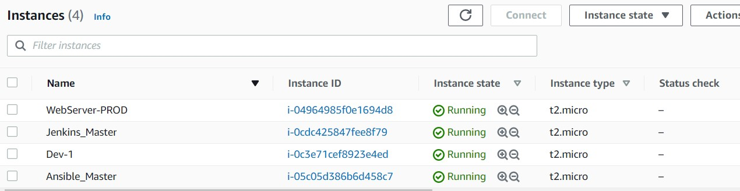
Step 1. Let's create four instances for our purpose.

Slide 5
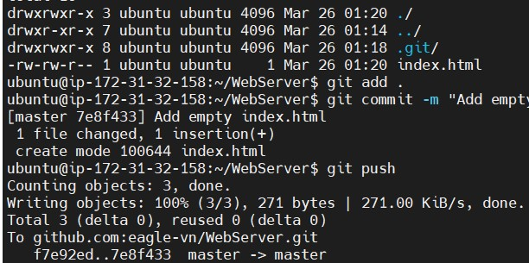
Step 2. Set up Git on Dev-workstation and connected it with GitHub repository
We going to use ec2 instances along this project. After we created instance for Developer we have to set up Git. Before that I created the repository to connect. For connecting to this repository I configured access via ssh.
Let's check if it's works with push.

Slide 6
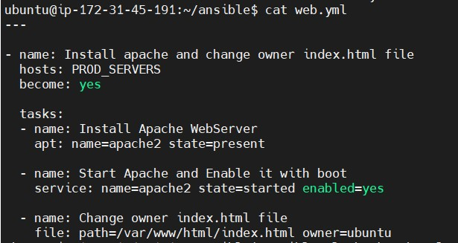
Step 3. Install Ansible and write playbook to configure our Web Server.
Using build-in modules we configure the state of our Web Server.
What this playbook is done? Install apache2, then configure it to be enabled with boot and change the owner of index.html so that we will be able to change it using Jenkins.

Slide 7
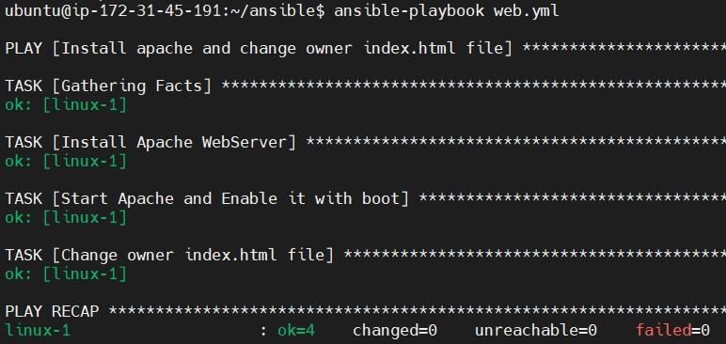
Check how it works.
I have run this playbook before so nothing has changed. Everything is already in the right state. And that's cool.

Slide 8
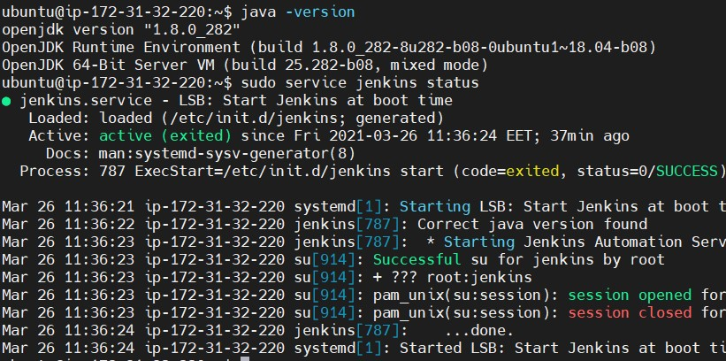
Step 4.Install Java and Jenkins. Connecting Jenkins and GitHub via Webhook.
I have already done these steps earlier, so we only need to check if everything is up and running. And it does!

Slide 9
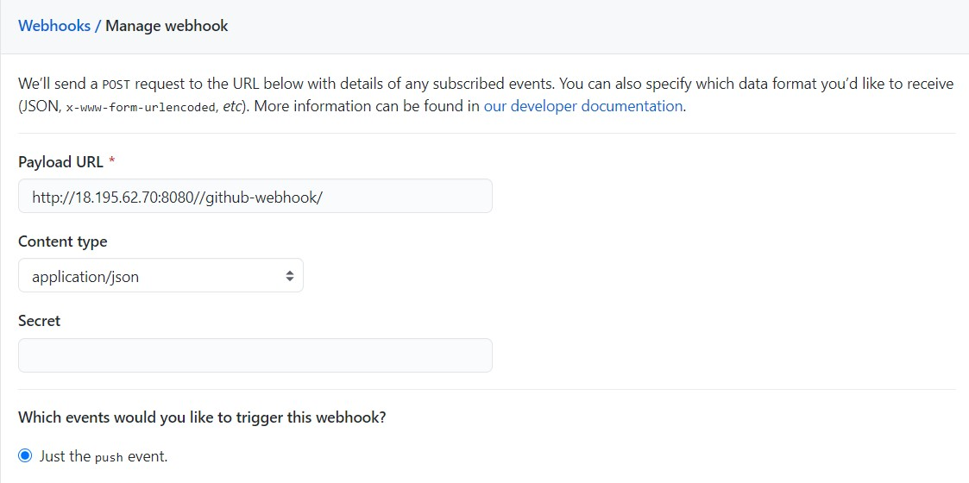
Configuring a trigger via a webhook
When our developer pushes something to the repository it will send a POST request to our Jenkins-Master. After that, Jenkins will be triggered to look if something new in this repository appears?

Slide 10
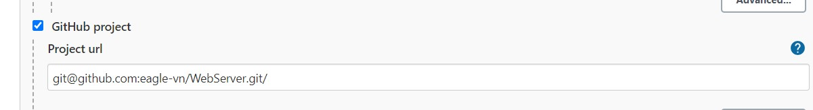
Step 5. Configure Build actions in Jenkins
We gonna use the following plugins: GitHub, Git, Publish Over SSH, SSH Agend. Let's make it done :)
So, here we put our GitHub repository to make the link between the following repo and Jenkins. We already placed this link in Step 4.

Slide 11
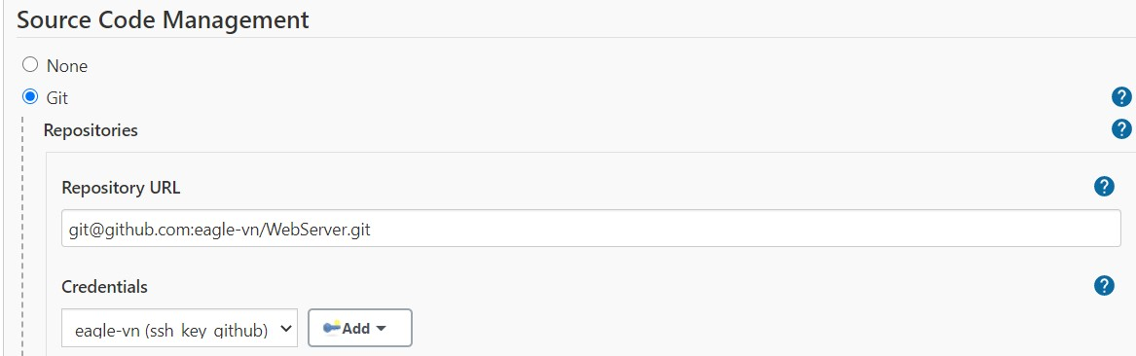
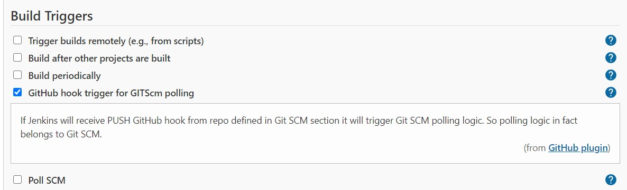
Pre-configuration for working with the remote repository.
Specify the repository to track. And also add the credentials for our repository.
Сheck the box to enable Triggers.

Slide 12
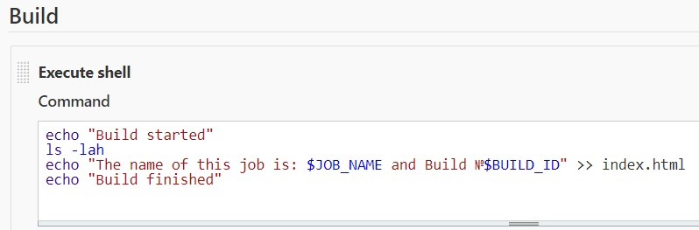
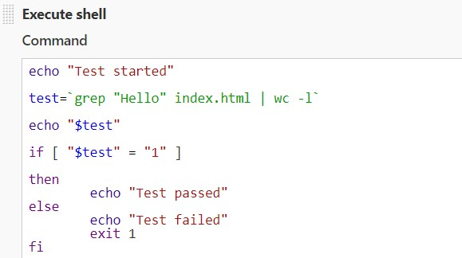
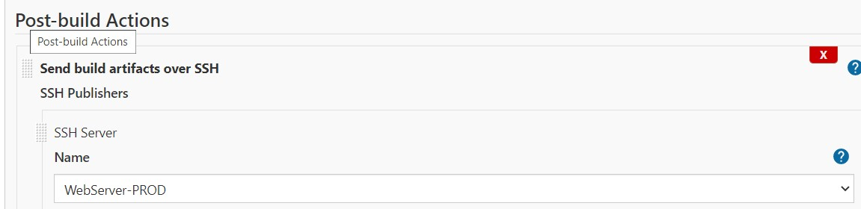
Add simple build actions, test and delivery to our Web Server.

Slide 13
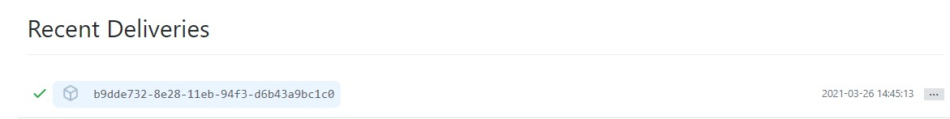
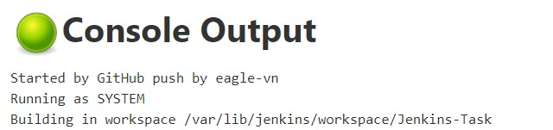
Let's check the result.
I changed the background and pushed it to our repository. Then build started via Webhook, tested, and delivered to the Web Server.

Slide 14
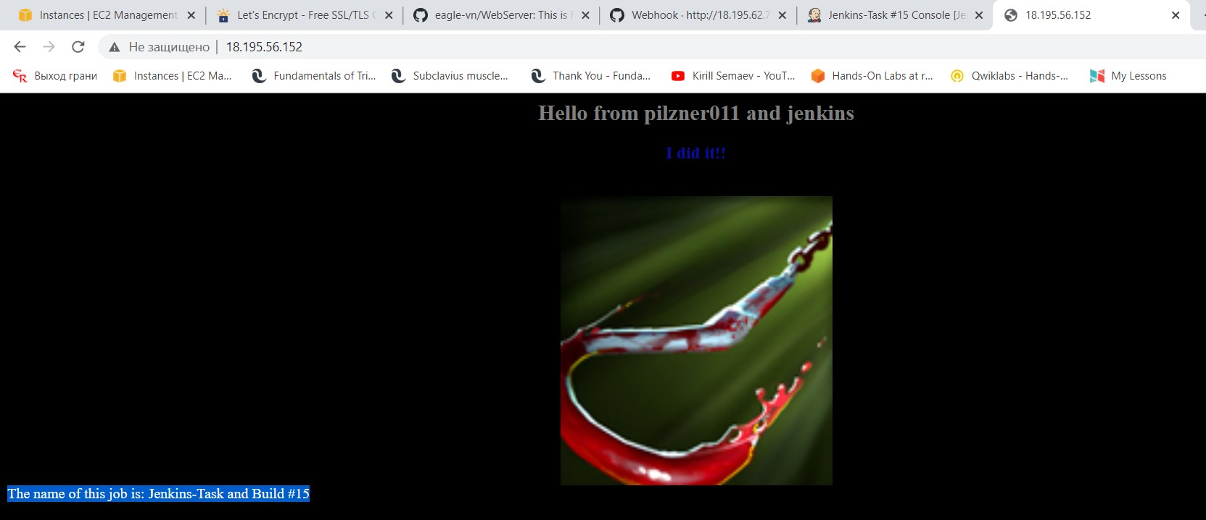
Thank you for attention!
Project by Volodymyr Sheshulkov

